Slide 1
RESTful APIs
Designing APIs in the REST style with examples in ASP.NET Web API
Presented by
Gregory M. Sohl

Slide 2
Background
Described in Roy Fielding dissertation in 2000
Roots back to 1994
Roy was a key contributor to HTTP and URI
Style of building APIs in distributed hypermedia systems
It is not
Particular Framework or Technology
Set of Standards
Design Pattern

Slide 3
REST
REprestational State Transfer
Transfer representations of resources in a particular State
Based on architectural style of WWW
Set of Constraints

Slide 4
Concepts
Resource
Has a URI
Conceptual mapping to one or more entities
URI
Address to a resource, it’s primary key

Slide 5
Concepts
Representation
Snapshot of a resource
NOT the resource itself
Media Type
A format for the representation
Commonly JSON or XML – but no limits

Slide 6
Constraints
Client / Server
Duh, it’s an interface from one thing to another
Separation of Concerns
Independent evolution
Stateless
Each request is independent
No stored context on the server

Slide 7
Constraints
Cache
Responses must indicate
Clients can choose to reuse
URIs
Resources are identified by URIs
Nouns instead of Verbs
Multiple URIs can refer to the same resource

Slide 8
Constraints
Uniform Interface
Resource based
HTTP verbs
POST, PUT, GET, DELETE, HEAD (for conditional GETs)
Generally ignore others, e.g. OPTIONS, PATCH and TRACE
HTTP result codes
Self-descriptive messages
Generalized media types

Slide 9
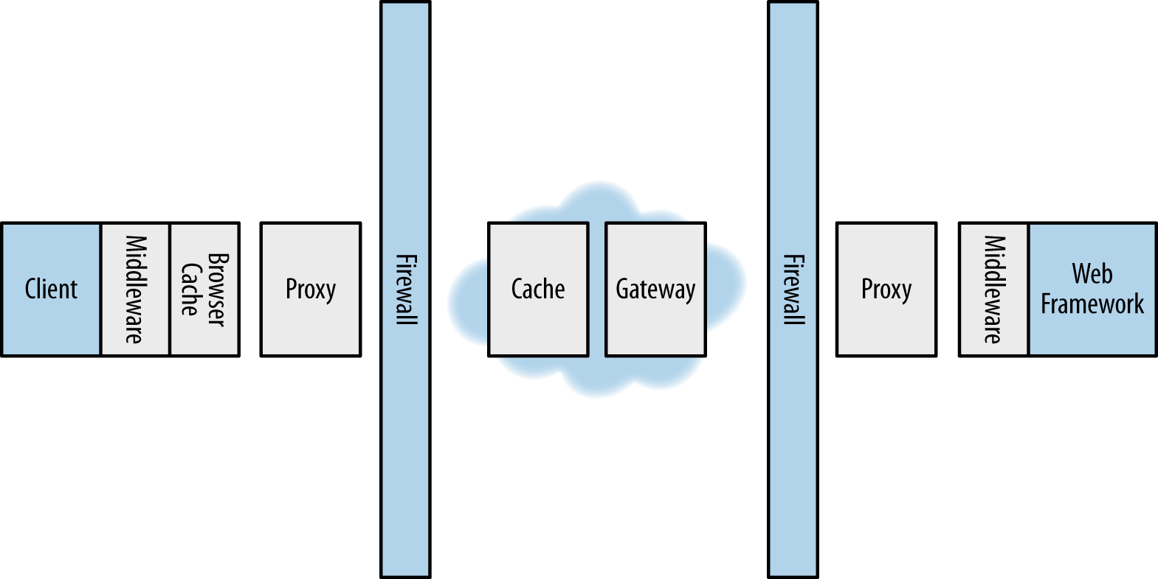
Constraints
Layered System
Client not necessarily talking directly to server
Layers can only “see” each other
Supports firewalls, proxies, etc.

Slide 10
Constraints
Code on Demand
Server can download code – change client behavior
Simplify client dev
Optional constraint

